Slide 1
Directed Acyclic Graphs
UIUC ECON 474 Econometrics of Policy Evaluation

Slide 2
Today
Reading for next class: Potential Outcomes
Ch 4 – 4.1.5 up to “replicating demand for learning HIV stats”
Directed Acyclic Graphs Anatomy
Backdoor Criterion
Three Real-World Collider Bias Examples
Which Controls to Include
Takeaways

Slide 3
Directed Acyclic Graphs Anatomy
Causal paths, backdoors, colliders

Slide 4
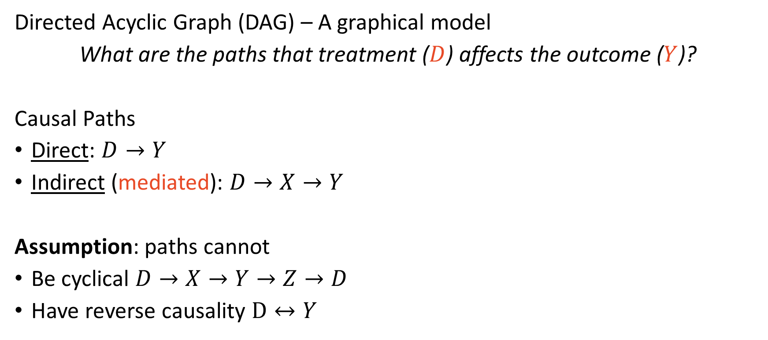
A Visual Representation of Causal Relationships
Directed Acyclic Graph (DAG) – A graphical model
What are the paths that treatment ($D$) affects the outcome ($Y$)?
Causal Paths
Direct: $D→Y$
Indirect (mediated): $D→X→Y$
Assumption: paths cannot
Be cyclical $D→X→Y→Z→D$
Have reverse causality $D↔Y$

Slide 5
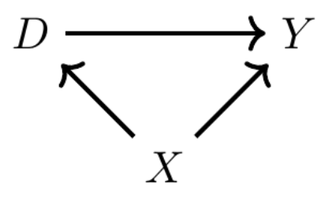
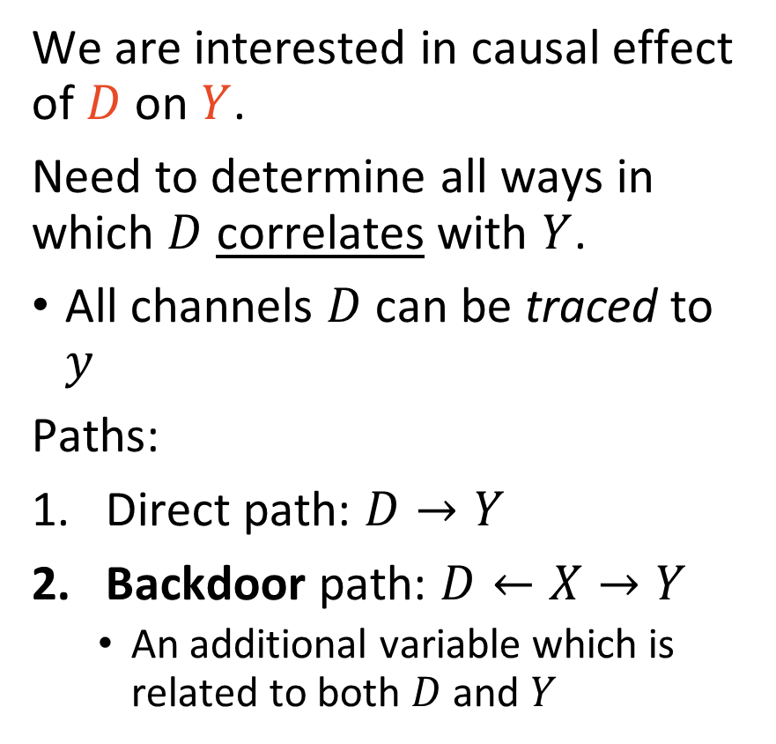
Paths in a DAG – A Simple Example
We are interested in causal effect of $D$ on $Y$.
Need to determine all ways in which $D$ correlates with $Y$.
All channels $D$ can be traced to $y$
Paths:
Direct path: $D→Y$
Backdoor path: $D←X→Y$
An additional variable which is related to both $D$ and $Y$

Slide 6
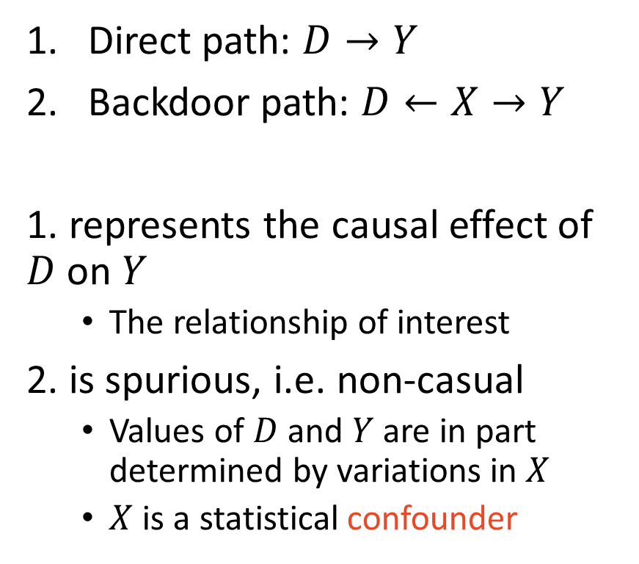
Paths in a DAG – A Simple Example
Direct path: $D→Y$
Backdoor path: $D←X→Y$
1. represents the causal effect of $D$ on $Y$
The relationship of interest
2. is spurious, i.e. non-casual
Values of $D$ and $Y$ are in part determined by variations in $X$
$X$ is a statistical confounder

Slide 7
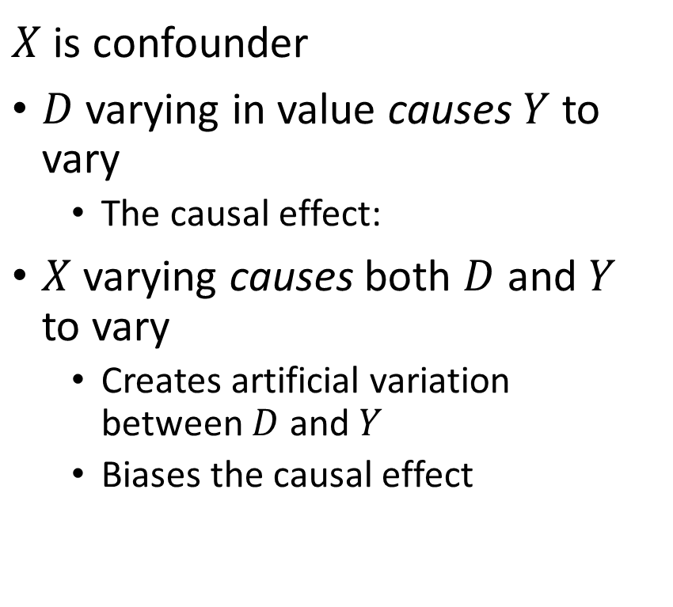
Paths in a DAG – A Simple Example
$X$ is confounder
$D$ varying in value causes $Y$ to vary
The causal effect:
$X$ varying causes both $D$ and $Y$ to vary
Creates artificial variation between $D$ and $Y$
Biases the causal effect

Slide 8
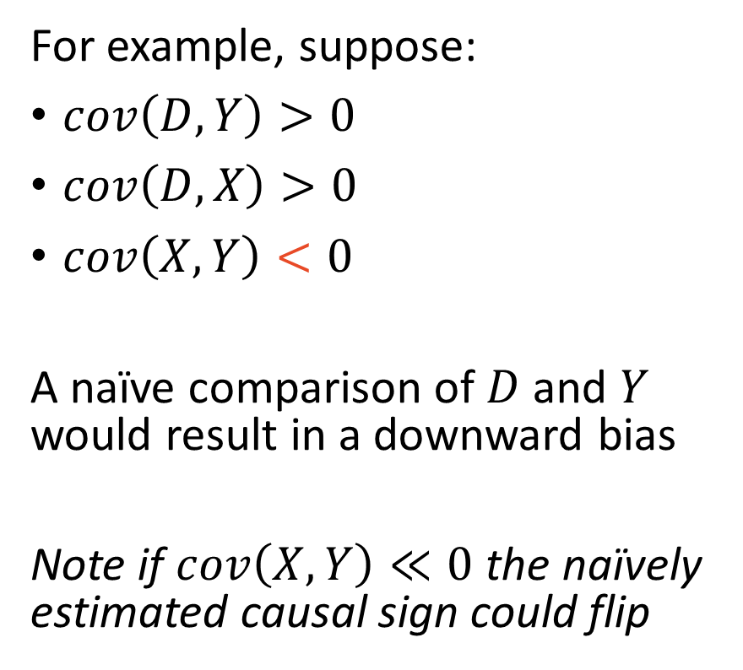
Paths in a DAG – A Simple Example
For example, suppose:
$cov\left(D,Y\right)>0$
$cov\left(D,X\right)>0$
$cov\left(X, Y\right)<0$
A naïve comparison of $D$ and $Y$ would result in a downward bias
Note if $cov\left(X, Y\right)≪0$ the naïvely estimated causal sign could flip

Slide 9
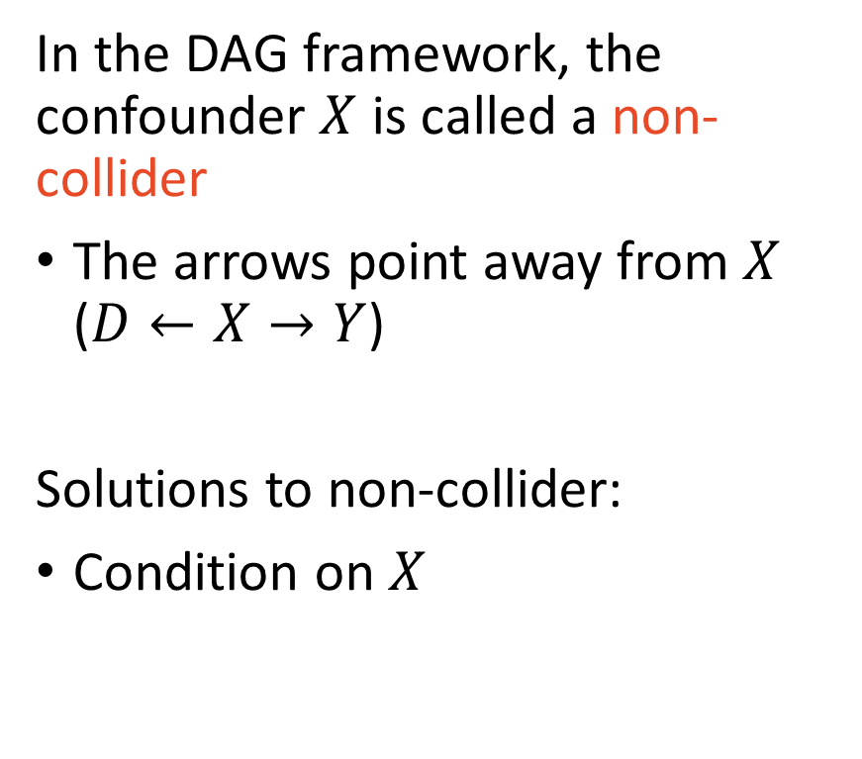
Paths in a DAG – A Simple Example
In the DAG framework, the confounder $X$ is called a non-collider
The arrows point away from $X$ ($D←X→Y$)
Solutions to non-collider:
Condition on $X$

Slide 10
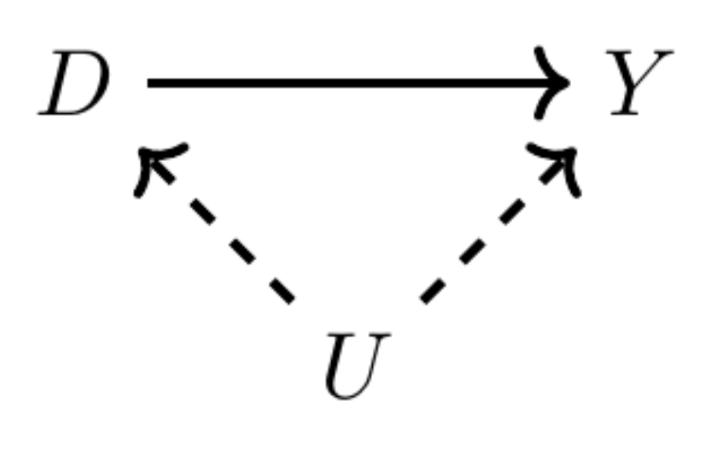
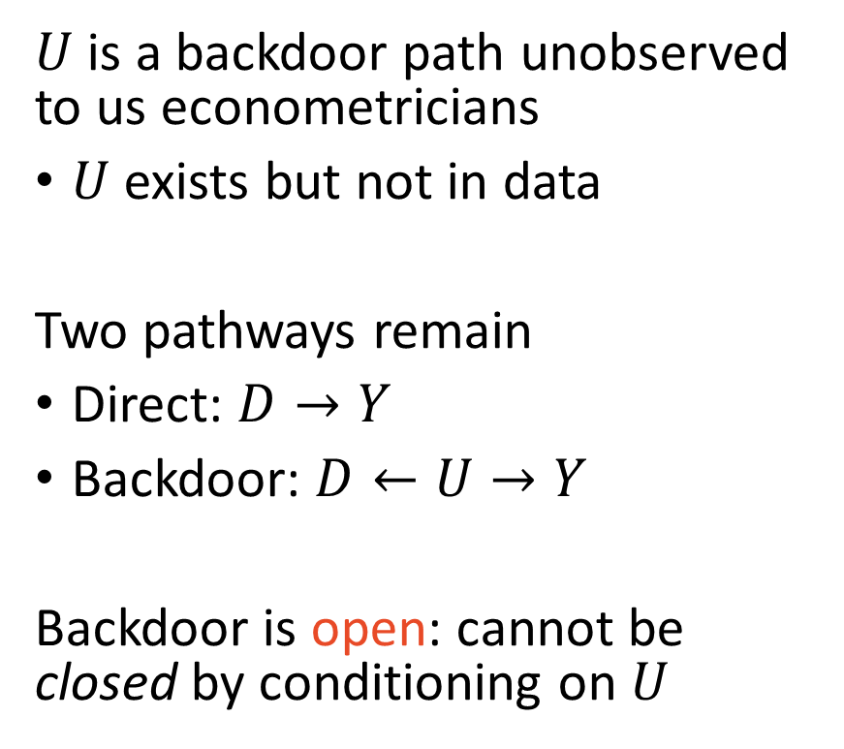
Paths in a DAG – Unobserved Variables
$U$ is a backdoor path unobserved to us econometricians
$U$ exists but not in data
Two pathways remain
Direct: $D→Y$
Backdoor: $D←U→Y$
Backdoor is open: cannot be closed by conditioning on $U$

Slide 11
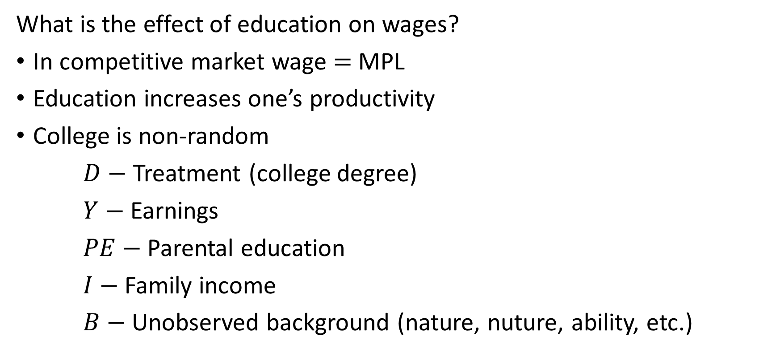
Becker 1994 – Human Capital Example
What is the effect of education on wages?
In competitive market wage $=$ MPL
Education increases one’s productivity
College is non-random
$D−$ Treatment (college degree)
$Y−$ Earnings
$PE−$ Parental education
$I−$ Family income
$B−$ Unobserved background (nature, nuture, ability, etc.)

Slide 12
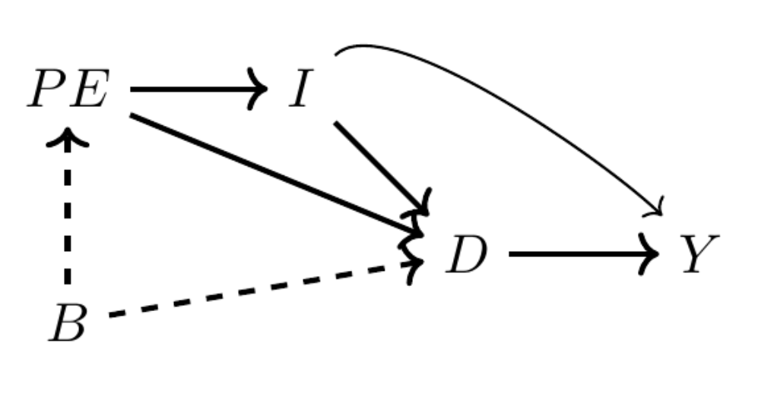
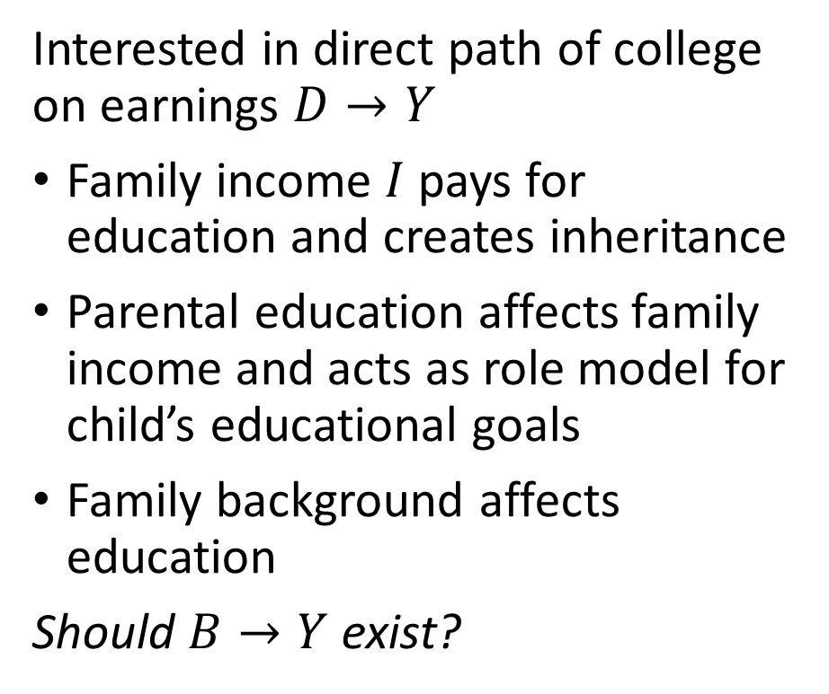
DAG of Human Capital Theory
Interested in direct path of college on earnings $D→Y$
Family income $I$ pays for education and creates inheritance
Parental education affects family income and acts as role model for child’s educational goals
Family background affects education
Should $B→Y$ exist?

Slide 13
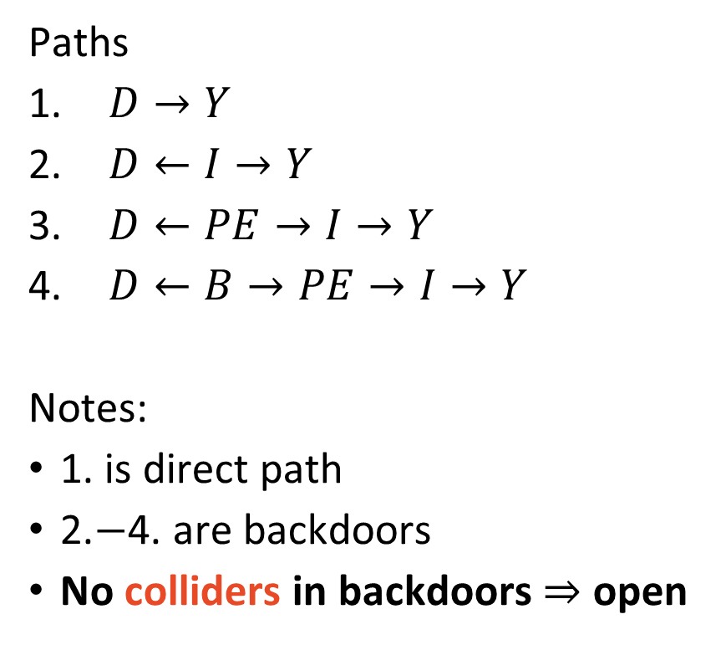
DAG of Human Capital Theory – Finding Paths
Paths
$D→Y$
$D←I→Y$
$D←PE→I→Y$
$D←B→PE→I→Y$
Notes:
1. is direct path
2.$−$4. are backdoors
No colliders in backdoors $⇒$ open

Slide 14
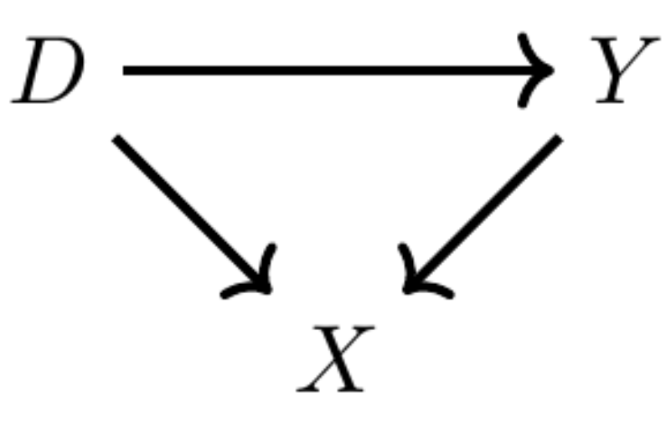
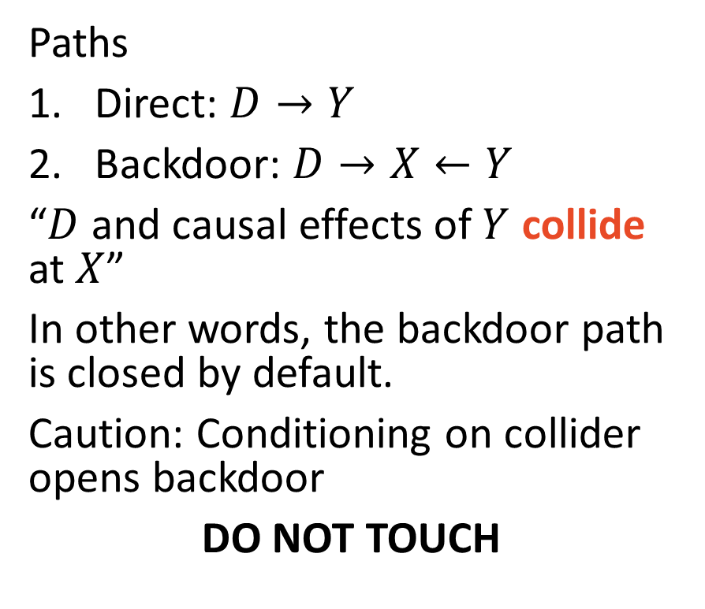
Colliders – The automatic backdoor closer
Paths
Direct: $D→Y$
Backdoor: $D→X←Y$
“$D$ and causal effects of $Y$ collide at $X$”
In other words, the backdoor path is closed by default.
Caution: Conditioning on collider opens backdoor
DO NOT TOUCH

Slide 15
The Backdoor Criterion
Isolating causal effects

Slide 16
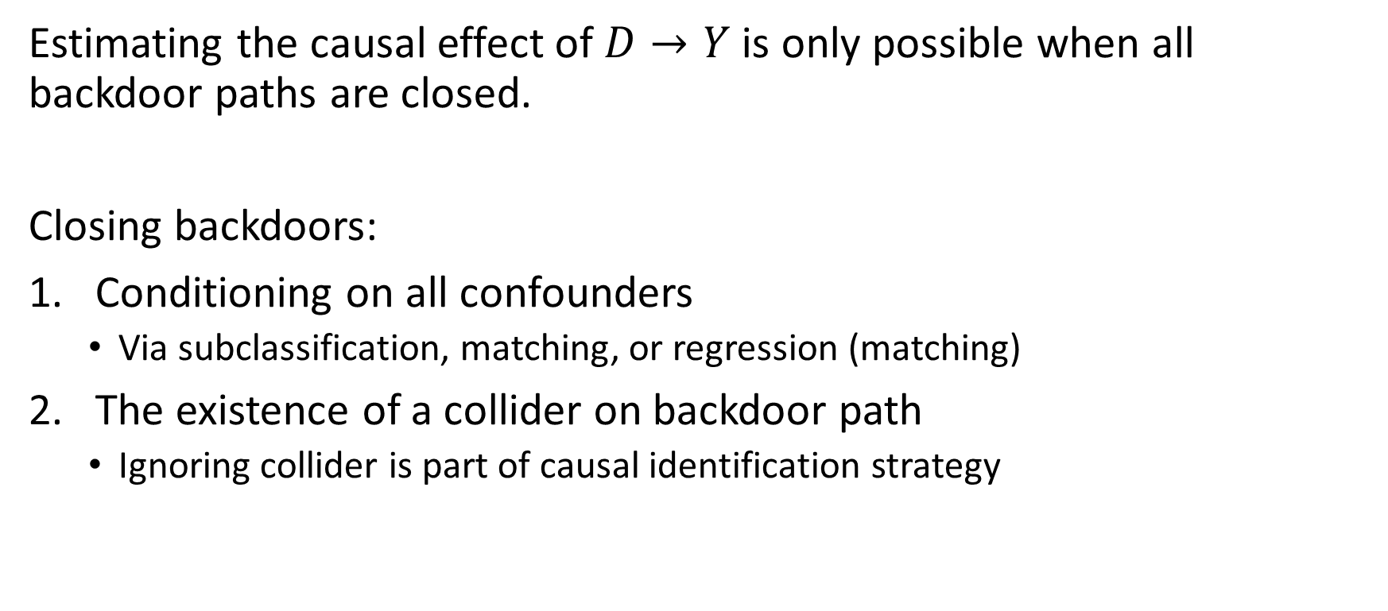
The Backdoor Criterion
Estimating the causal effect of $D→Y$ is only possible when all backdoor paths are closed.
Closing backdoors:
Conditioning on all confounders
Via subclassification, matching, or regression (matching)
The existence of a collider on backdoor path
Ignoring collider is part of causal identification strategy

Slide 17
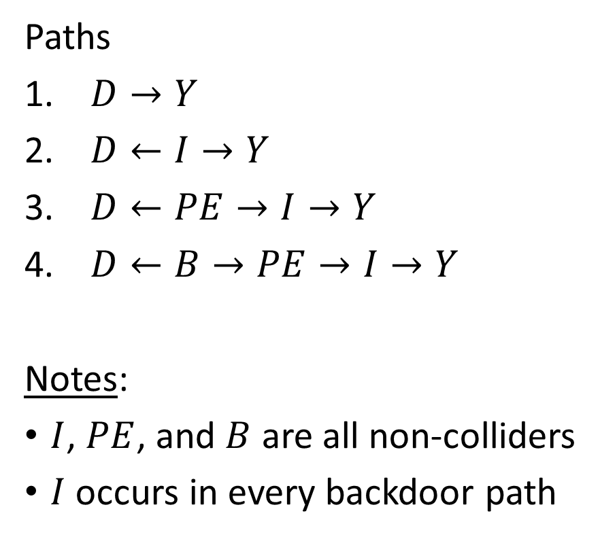
Back to Becker 1994
Paths
$D→Y$
$D←I→Y$
$D←PE→I→Y$
$D←B→PE→I→Y$
Notes:
$I$, $PE$, and $B$ are all non-colliders
$I$ occurs in every backdoor path

Slide 18
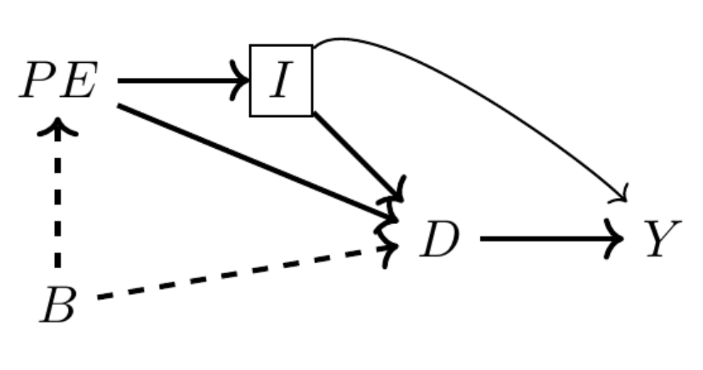
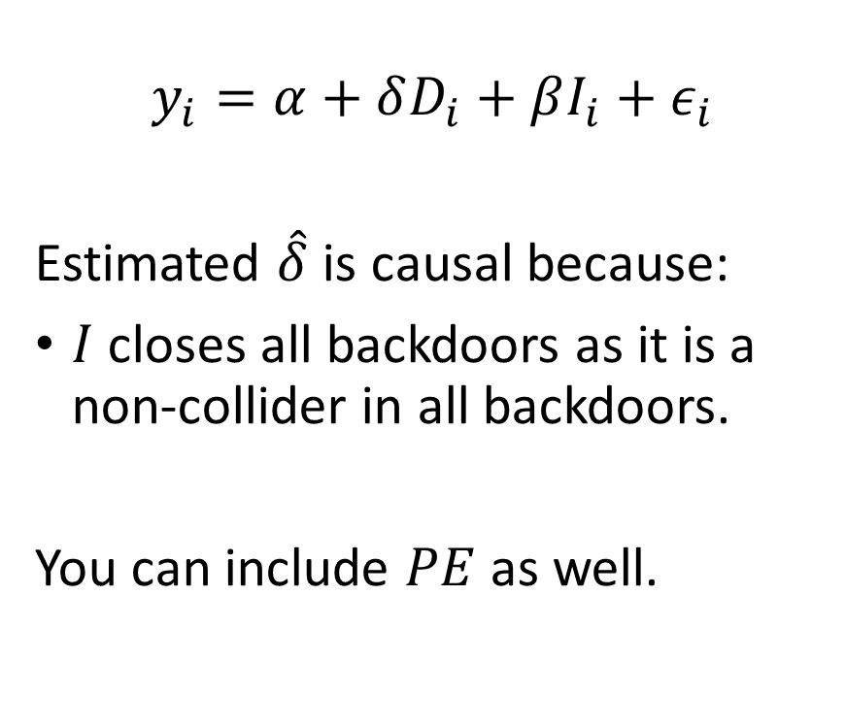
Minimally sufficient conditioning strategy
$$y_{i}=α+δD_{i}+βI_{i}+ε_{i}$$
Estimated $\hat{δ}$ is causal because:
$I$ closes all backdoors as it is a non-collider in all backdoors.
You can include $PE$ as well.

Slide 19
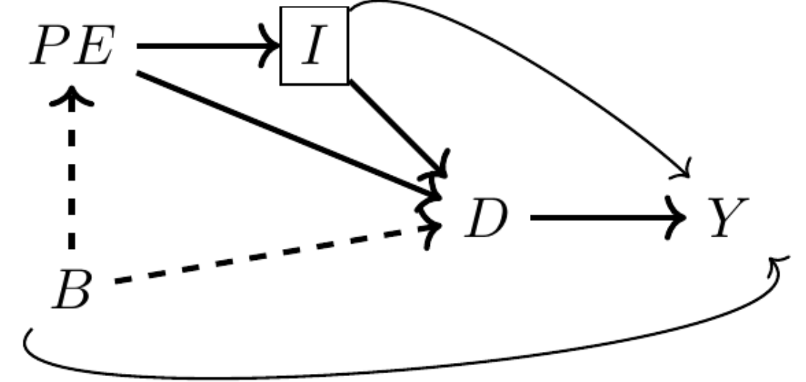
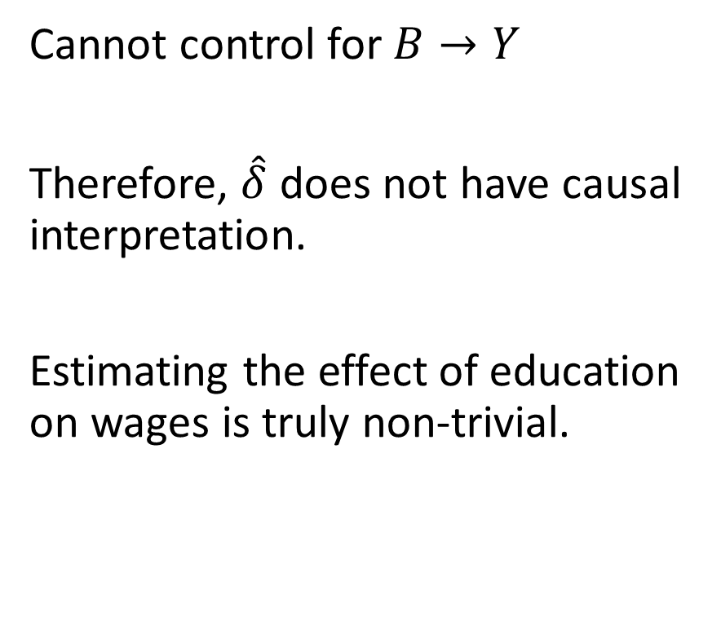
Background likely has direct effect on earnings
Cannot control for $B→Y$
Therefore, $\hat{δ}$ does not have causal interpretation.
Estimating the effect of education on wages is truly non-trivial.

Slide 20
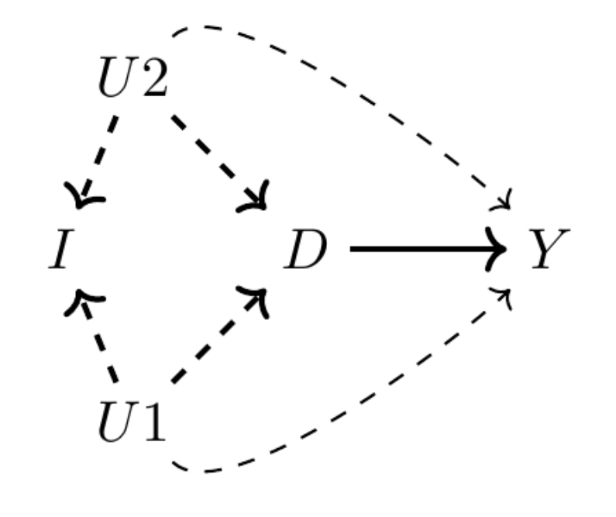
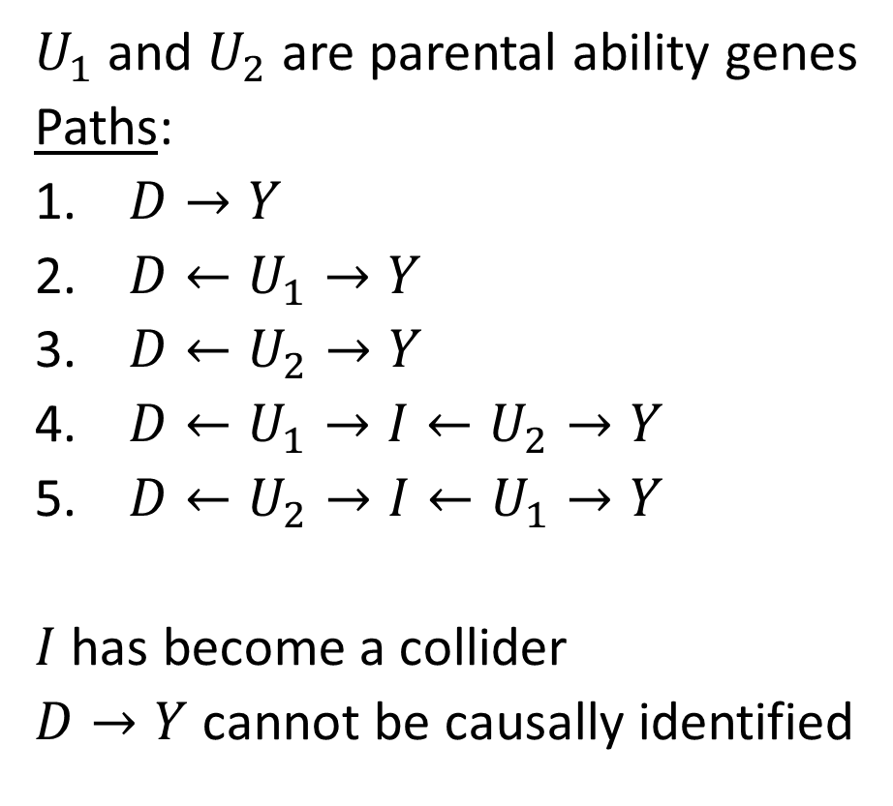
How colliders could exist in education-wage model
$U_{1}$ and $U_{2}$ are parental ability genes
Paths:
$D→Y$
$D←U_{1}→Y$
$D←U_{2}→Y$
$D←U_{1}→I←U_{2}→Y$
$D←U_{2}→I←U_{1}→Y$
$I$has become a collider
$D→Y$ cannot be causally identified

Slide 21
Three Collider Bias Examples
Gender discrimination, movie stars, and racial profiling

Slide 22
Labor Market Gender Discrimination
An example:
Google was criticized for systematically underpaying its female employees
Google showed no gender wage gap existed after conditioning on
Location
Tenure
Job role
Job level
Performance
What if gender pay gap exists because of discrimination in the job ladder?

Slide 23
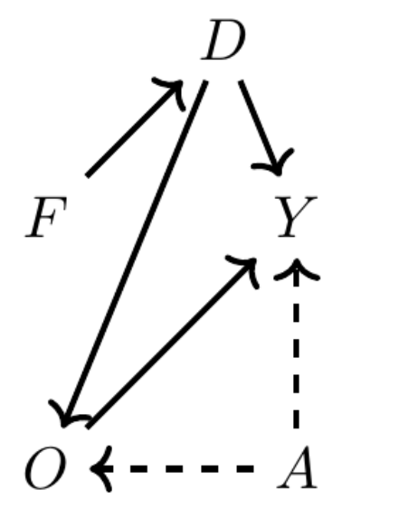
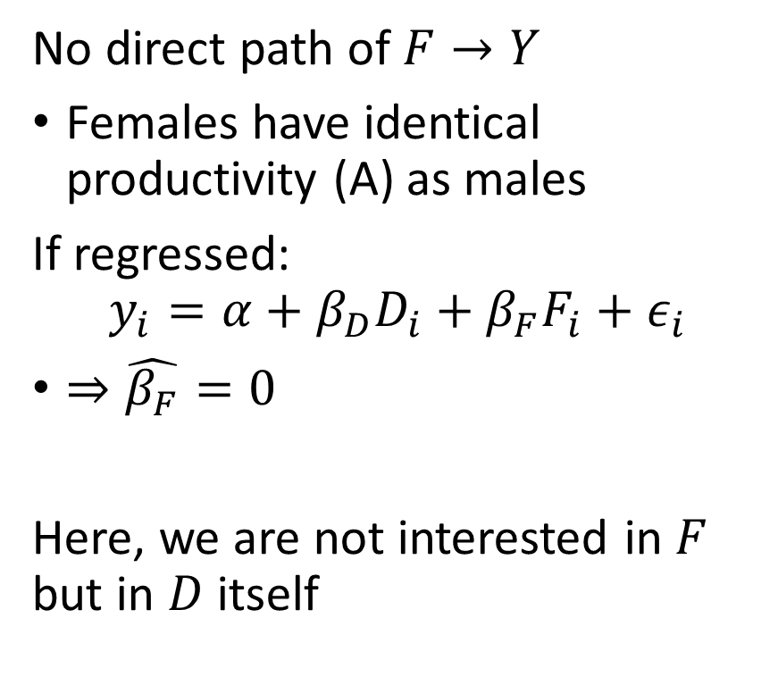
Occupational Sorting w/ Unobserved Heterogeneity
No direct path of $F→Y$
Females have identical productivity (A) as males
If regressed:
$$y_{i}=α+β_{D}D_{i}+β_{F}F_{i}+ε_{i}$$
$⇒\hat{β_{F}}=0$
Here, we are not interested in $F$ but in $D$ itself

Slide 24
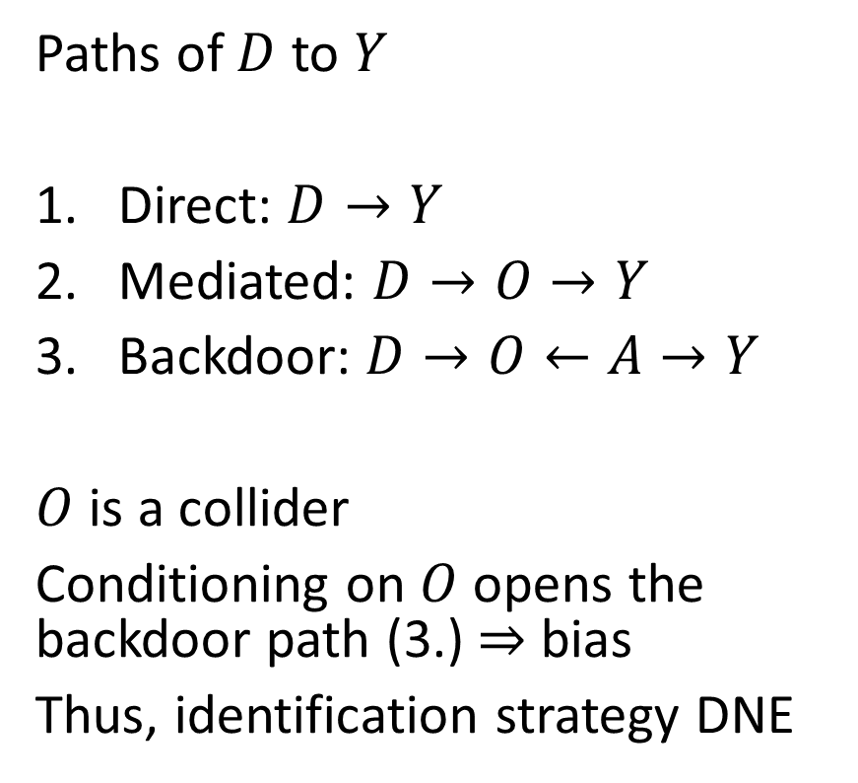
Occupational Sorting w/ Unobserved Heterogeneity
Paths of $D$ to $Y$
Direct: $D→Y$
Mediated: $D→O→Y$
Backdoor: $D→O←A→Y$
$O$ is a collider
Conditioning on $O$ opens the backdoor path (3.) $⇒$ bias
Thus, identification strategy DNE

Slide 25
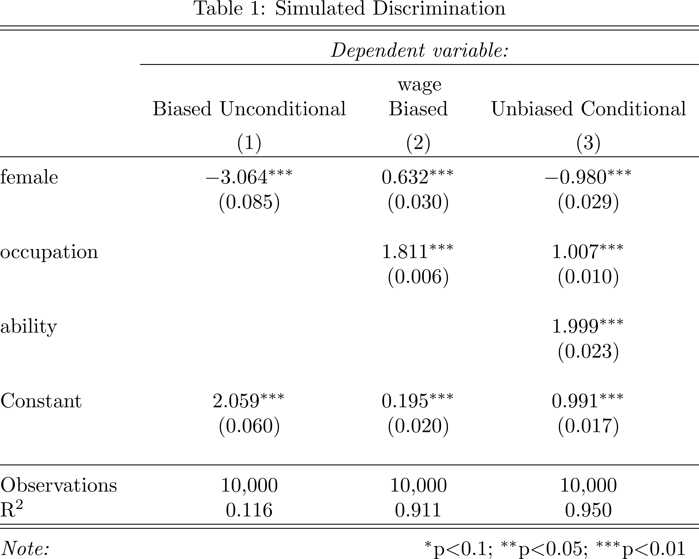
Gender Discrimination - Generated Data

Slide 26
Movie Stars
Sample bias

Slide 27



Sample selection – Becoming a movie star
From the text:
“A 2009 CNN blog post reported that Megan Fox, who starred in the movie Transformers, was voted the worst and most attractive actress of 2009.”
Julian also votes for Tom Cruise
vs.

Slide 28
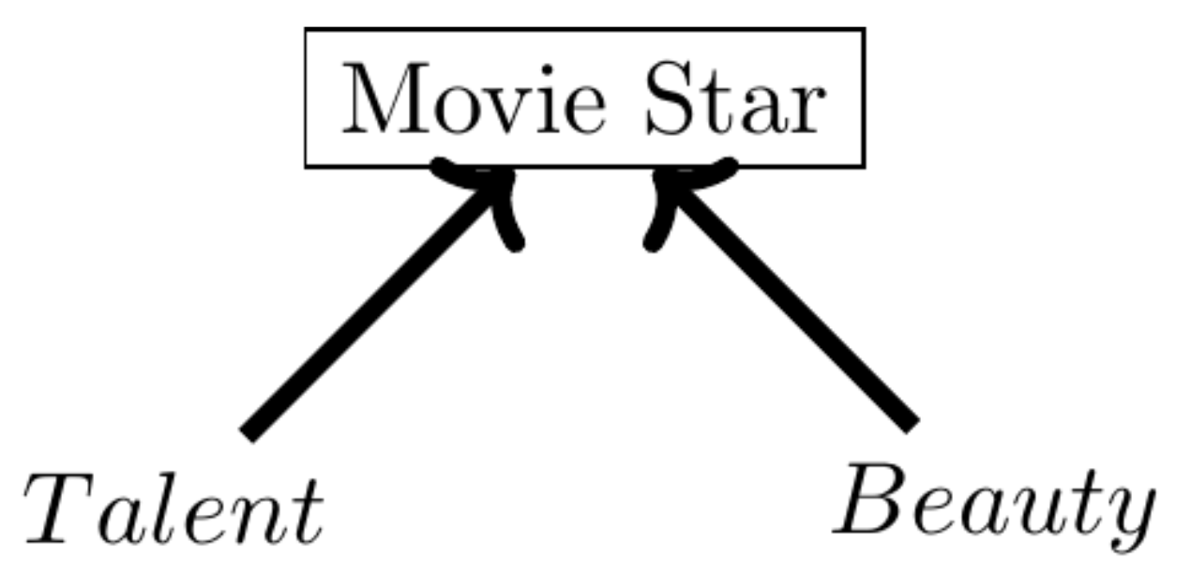
Sample selection – Becoming a movie star
Are talent and beauty negatively correlated?
Generate some data from DAG:

Slide 29
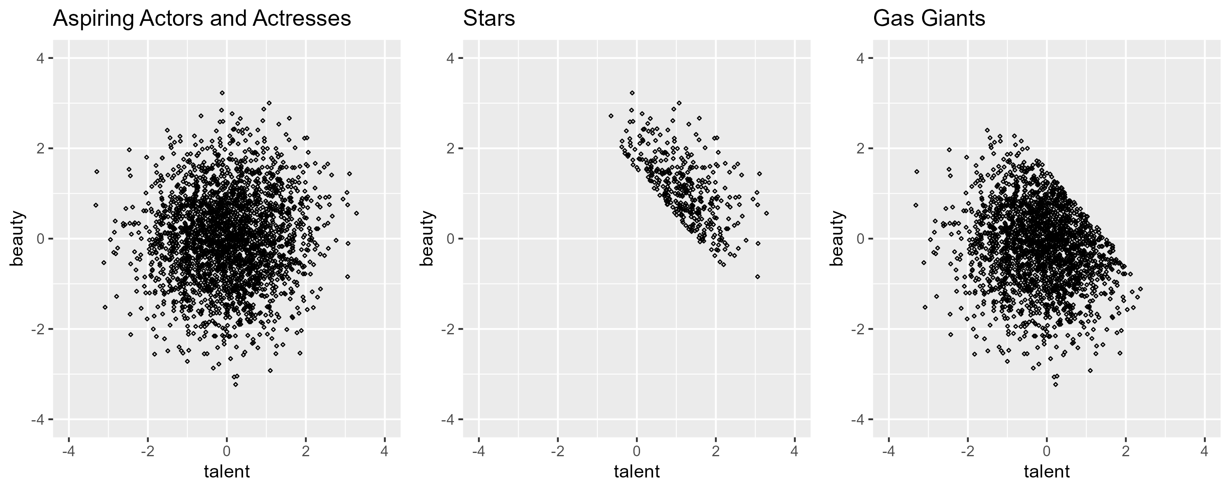
Stars are top 85% of beauty + talent

Slide 30
Racial Profiling
Sample bias

Slide 31
Racial profiling – a subtle case of sample selection
A tale how amazing data cannot solve your causal identification issues.
Growing public concern of perceived police racial profiling from white police officers killing black citizens
Trayvon Martin (2012-02-26) – “a suspicious person”
Michael Brown (2014-09-09) – Ferguson police department
Eric Garner (2015-06-13) – “I can’t breathe”
George Floyd (2020-03-25) – Knelt on
https://sayevery.name/
Lead to Black Lives Matter movement in 2013

Slide 32
Fryer (2019) – Quantify police force racial bias
Undertook incredible data collection legwork
Two types of data:
Survey data of citizens experience of police interactions
Administrative police department data interactions with civilians

Slide 33
Fryer (2019) – Quantify police force racial bias
Findings from the sources:
Survey data – With over 100 controls for demographics, encounter characteristics, suspected weapon, precinct, year
Blacks and Hispanics are 50% more likely than whites to have police interaction
Blacks 21% more likely than whites to have police interaction with police gun drawn
Administrative data – no racial difference in officer shootings

Slide 34
Fryer (2019) – Quantify police force racial bias
Why do the survey data results differ from the administrative data?
Are police departments cooking their data?
Are the police departments participating in the study the ones without racial bias?
Is the difference baked in to how the data are collected?

Slide 35
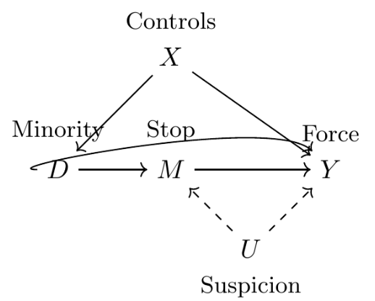
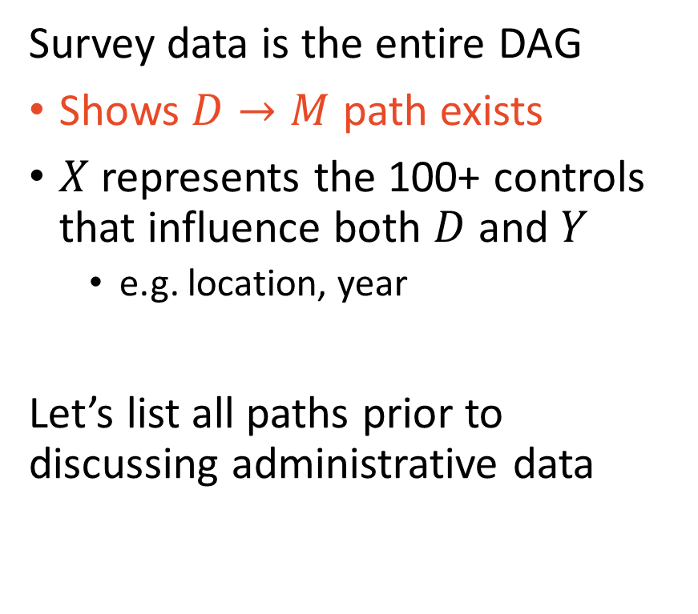
Administrative data is conditional on a collider
Survey data is the entire DAG
Shows $D→M$ path exists
$X$ represents the 100+ controls that influence both $D$ and $Y$
e.g. location, year
Let’s list all paths prior to discussing administrative data

Slide 36
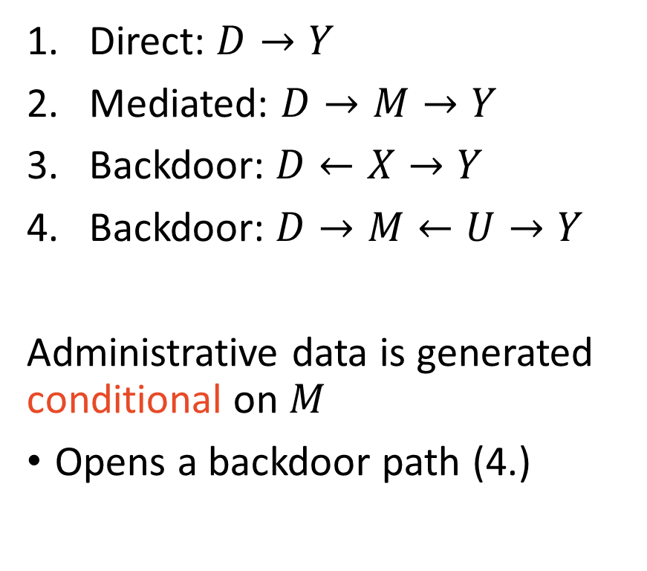
Administrative data is conditional on a collider
Direct: $D→Y$
Mediated: $D→M→Y$
Backdoor: $D←X→Y$
Backdoor: $D→M←U→Y$
Administrative data is generated conditional on $M$
Opens a backdoor path (4.)

Slide 37
Knox et al 2020 – Sample bias correction procedure
Procedure is advanced and beyond the scope of this course
Nonetheless, good to be aware it exists
Their findings show correction procedure estimates are at least 5x higher than sample-selection naïve approach

Slide 38

What are we controlling for?
So, I have my data and know what $D$ and $Y$ are. Now what?

Slide 39
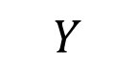
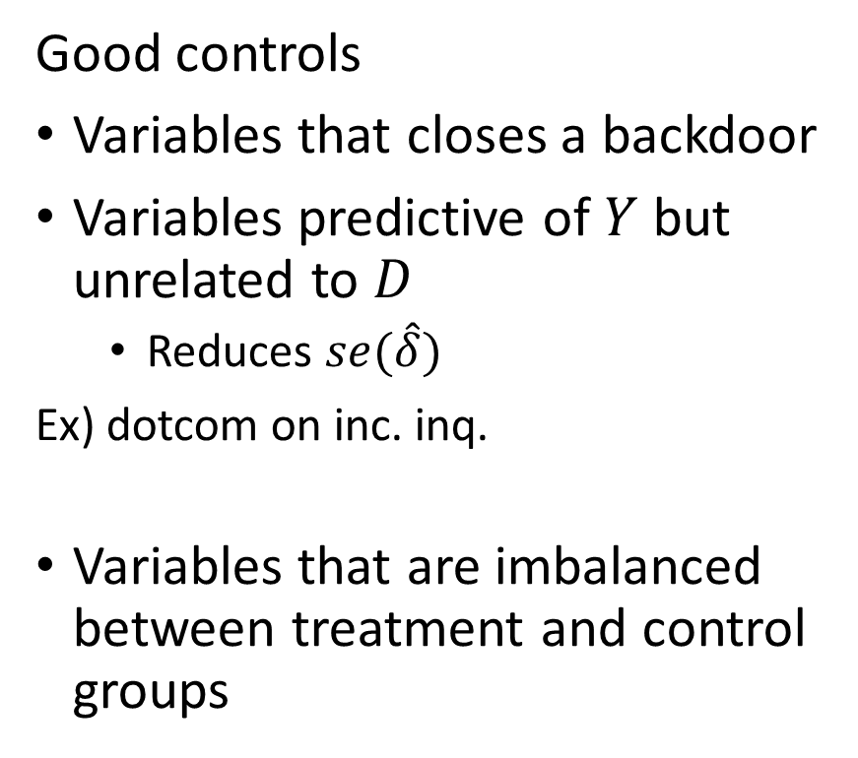
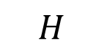
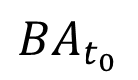
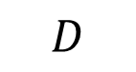
Conditioning on Control Variables
Bad controls
Colliders
Variables determined after treatment
Ex) Occupation in regression of education on wages
Good controls
Variables that closes a backdoor
Variables predictive of $Y$ but unrelated to $D$
Reduces $se(\hat{δ})$
Ex) dotcom on inc. inq.
Variables that are imbalanced between treatment and control groups
$$H$$
$$D$$
$$Y$$
$$BA_{t_{0}}$$

Slide 40
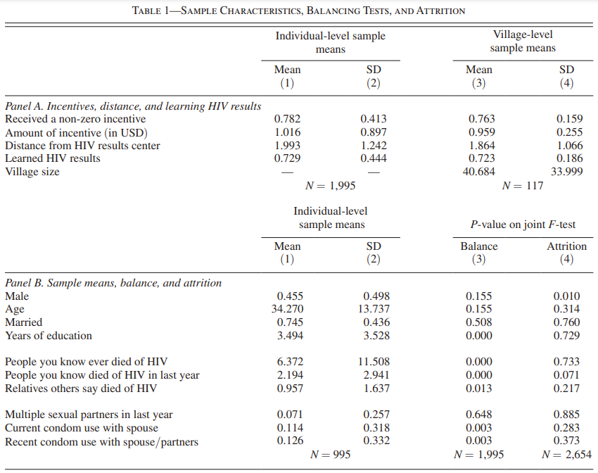

Slide 41

Takeaways

Slide 42
Identifying causal relationships is non-trivial
We just spent a bunch of time on what can go wrong
We will talk about what can go right soon!
Control for confounders, don’t control for collider
Unobservable variables a troublesome (foreshadow: can be dealt with)
Think carefully about how your data are collected

